Slide 1
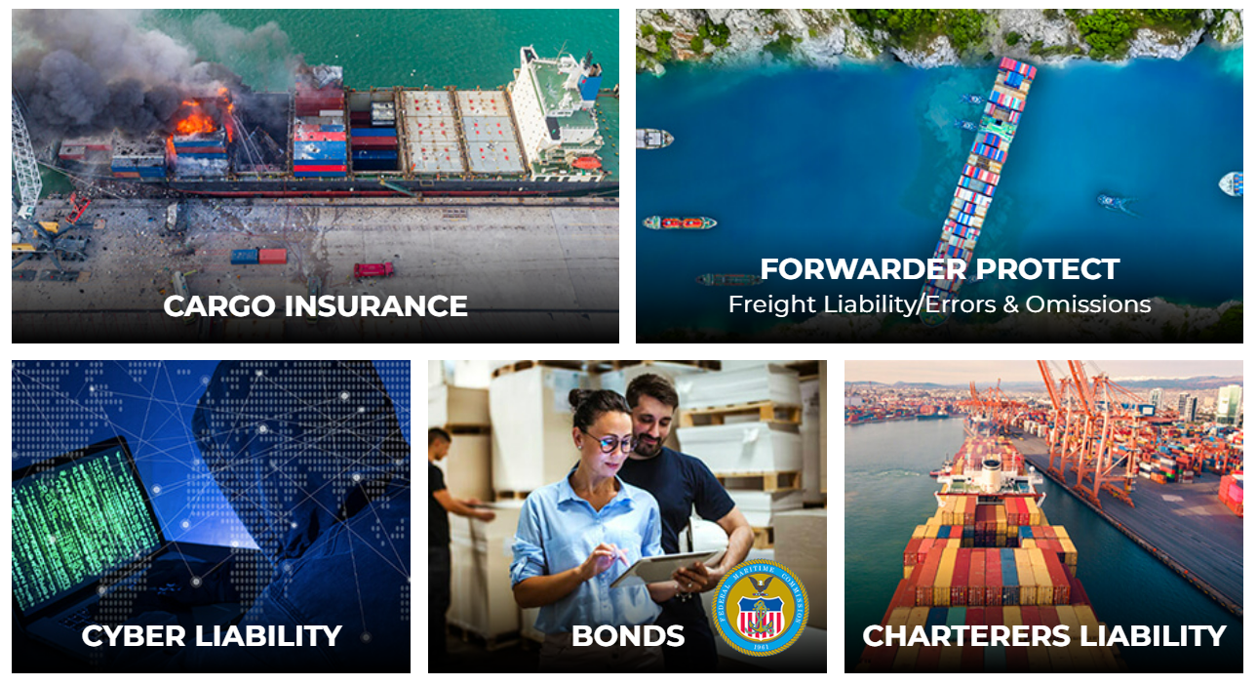
PRODUCTS
SERVICES
Gold & Platinum Level Membership: the ultimate policies for qualifying members.
EasyPay: premium finance assistance for qualified members.
PartnerPay: premium finance assistance for qualified members.
Training & Education: across a variety of topics of interest to freight forwarders.
Risk Assessments: 365 review of core trading protocols to help mitigate financial risk.

Slide 2
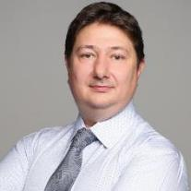
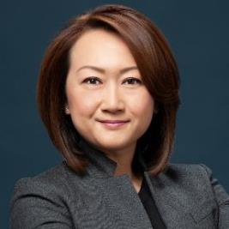
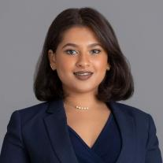
Richard Kamppari Baker
Claims Director
Switzerland
Angus Galbraith
Senior Underwriter
United Kingdom & United States
Amy Fung
Administration Manager
Hong Kong, China
Monica Lee
Chief Executive Officer
United States
Our Team
Sandra Velasquez
Senior Broker & Broker Support Manager - United States
Fei Yu (Fisher) Wang
Business Development Director
China
Lisa Ng
Broker, Asia Pacific
[Azure Risk]
Hong Kong, China
Greg J. Kritz, CIC
Executive Vice President
United States
Anmol Sawlani
Director
Asia Pacific [Azure Risk]
Hong Kong, China
Tanya Venkatraman
Business Development Manager Asia Pacific [Azure Risk]
Hong Kong, China
Mauricio Larenas
President
FMC Bond & Registration [AP Tariffs]
United States

Slide 3
We aim to two do things:
Help Forwarders Increase Revenue
Protect Forwarder’s Balance Sheet

Slide 4
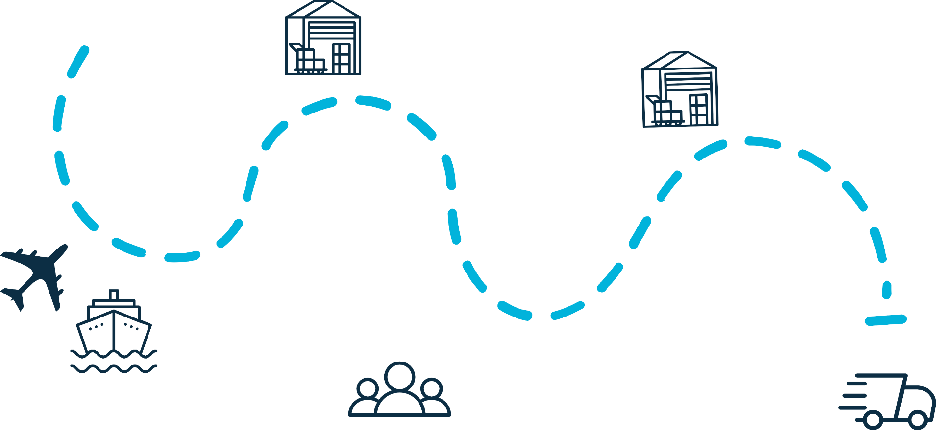
INSURING YOUR SUPPLY CHAIN
Ground Transportation
Collision
Overturn
Mishandling
Theft
Warehouse/Container Yard
Theft
Accidental Damage
Weather Damage
Disposal/destruction costs
Warehouse/Container Yard
Theft
Accidental Damage
Weather Damage
Disposal/destruction costs
Shipment (Air & Sea)
General average
Accidents, e.g. dropping on loading
Container Jettison
Hijacking
Weather
Forwarder Liability
Delay of freight due to negligence
Misdirection/delivery
Incomplete documents
Release without BOL
Misclassification
Ground Transportation
Collision
Overturn
Mishandling
Theft

Slide 5
Cargo Insurance – Brief Overview
What is Cargo Insurance?
Marine cargo insurance provides cover against loss of or damage to the cargo shipped by water, by air or by land, whether on a domestic or international voyage.
Who has Insurable Interest?
The cargo owner
From “Place”
Cargo Insurance
To “Place”

Slide 6
Institute Cargo Clauses A, B and C
Institute Cargo Clauses | ICC (A) | ICC (C)
Proximate Causes
1. Stranding, Grounding, Sinking or Capsizing
2. Overturning or Derailment of Land Conveyance
3. Collision of ship, craft with another ship or craft
4. Contact of Ship, Craft or Conveyance with anything other than Ship or Craft (excluding water but includes ice)
5. Discharge of Cargo at Port of Distress
6. Fire or Explosion
7. Earthquake, Volcanic Eruption or Lighting
8. General Average and Salvage Charges
9. Jettison
10. Washing Overboard (Deck cargo)
11. Malicious Damage
12. Theft, Pilferage or Robbery
13. Non-delivery of entire shipping package
14. Piracy
15. Entry of Sea Water into the Ship, Craft, Hold, Conveyance, Container, Liftvan or Place of Storage
16. Entry of River or Lake water into the same
17. Rainwater
18. Loss or damage during loading/discharge from vessel
19. Loss overboard during loading/discharge from vessel (total loss only)
20. Other physical loss or damage not specified and not excluded

Slide 7
WAVE: Proprietary, World Class
Automotion Tool
Our WAVE TM technology platform is one of the world’s easiest and most advanced cargo insurance, freight liability & policy issuance systems.
Users enjoy its simplicity and speed
Features include an internal “message” option, auto-quote form, currency converter, ability to send automatic referrals directly to insurer/broker
24-hr access by computer or portable device
WAVE has its own API that integrates easily with most transportation management systems.
Two Ways: WCA Cargo Insurance Programs or Tailored Open Cover Policies

Slide 8
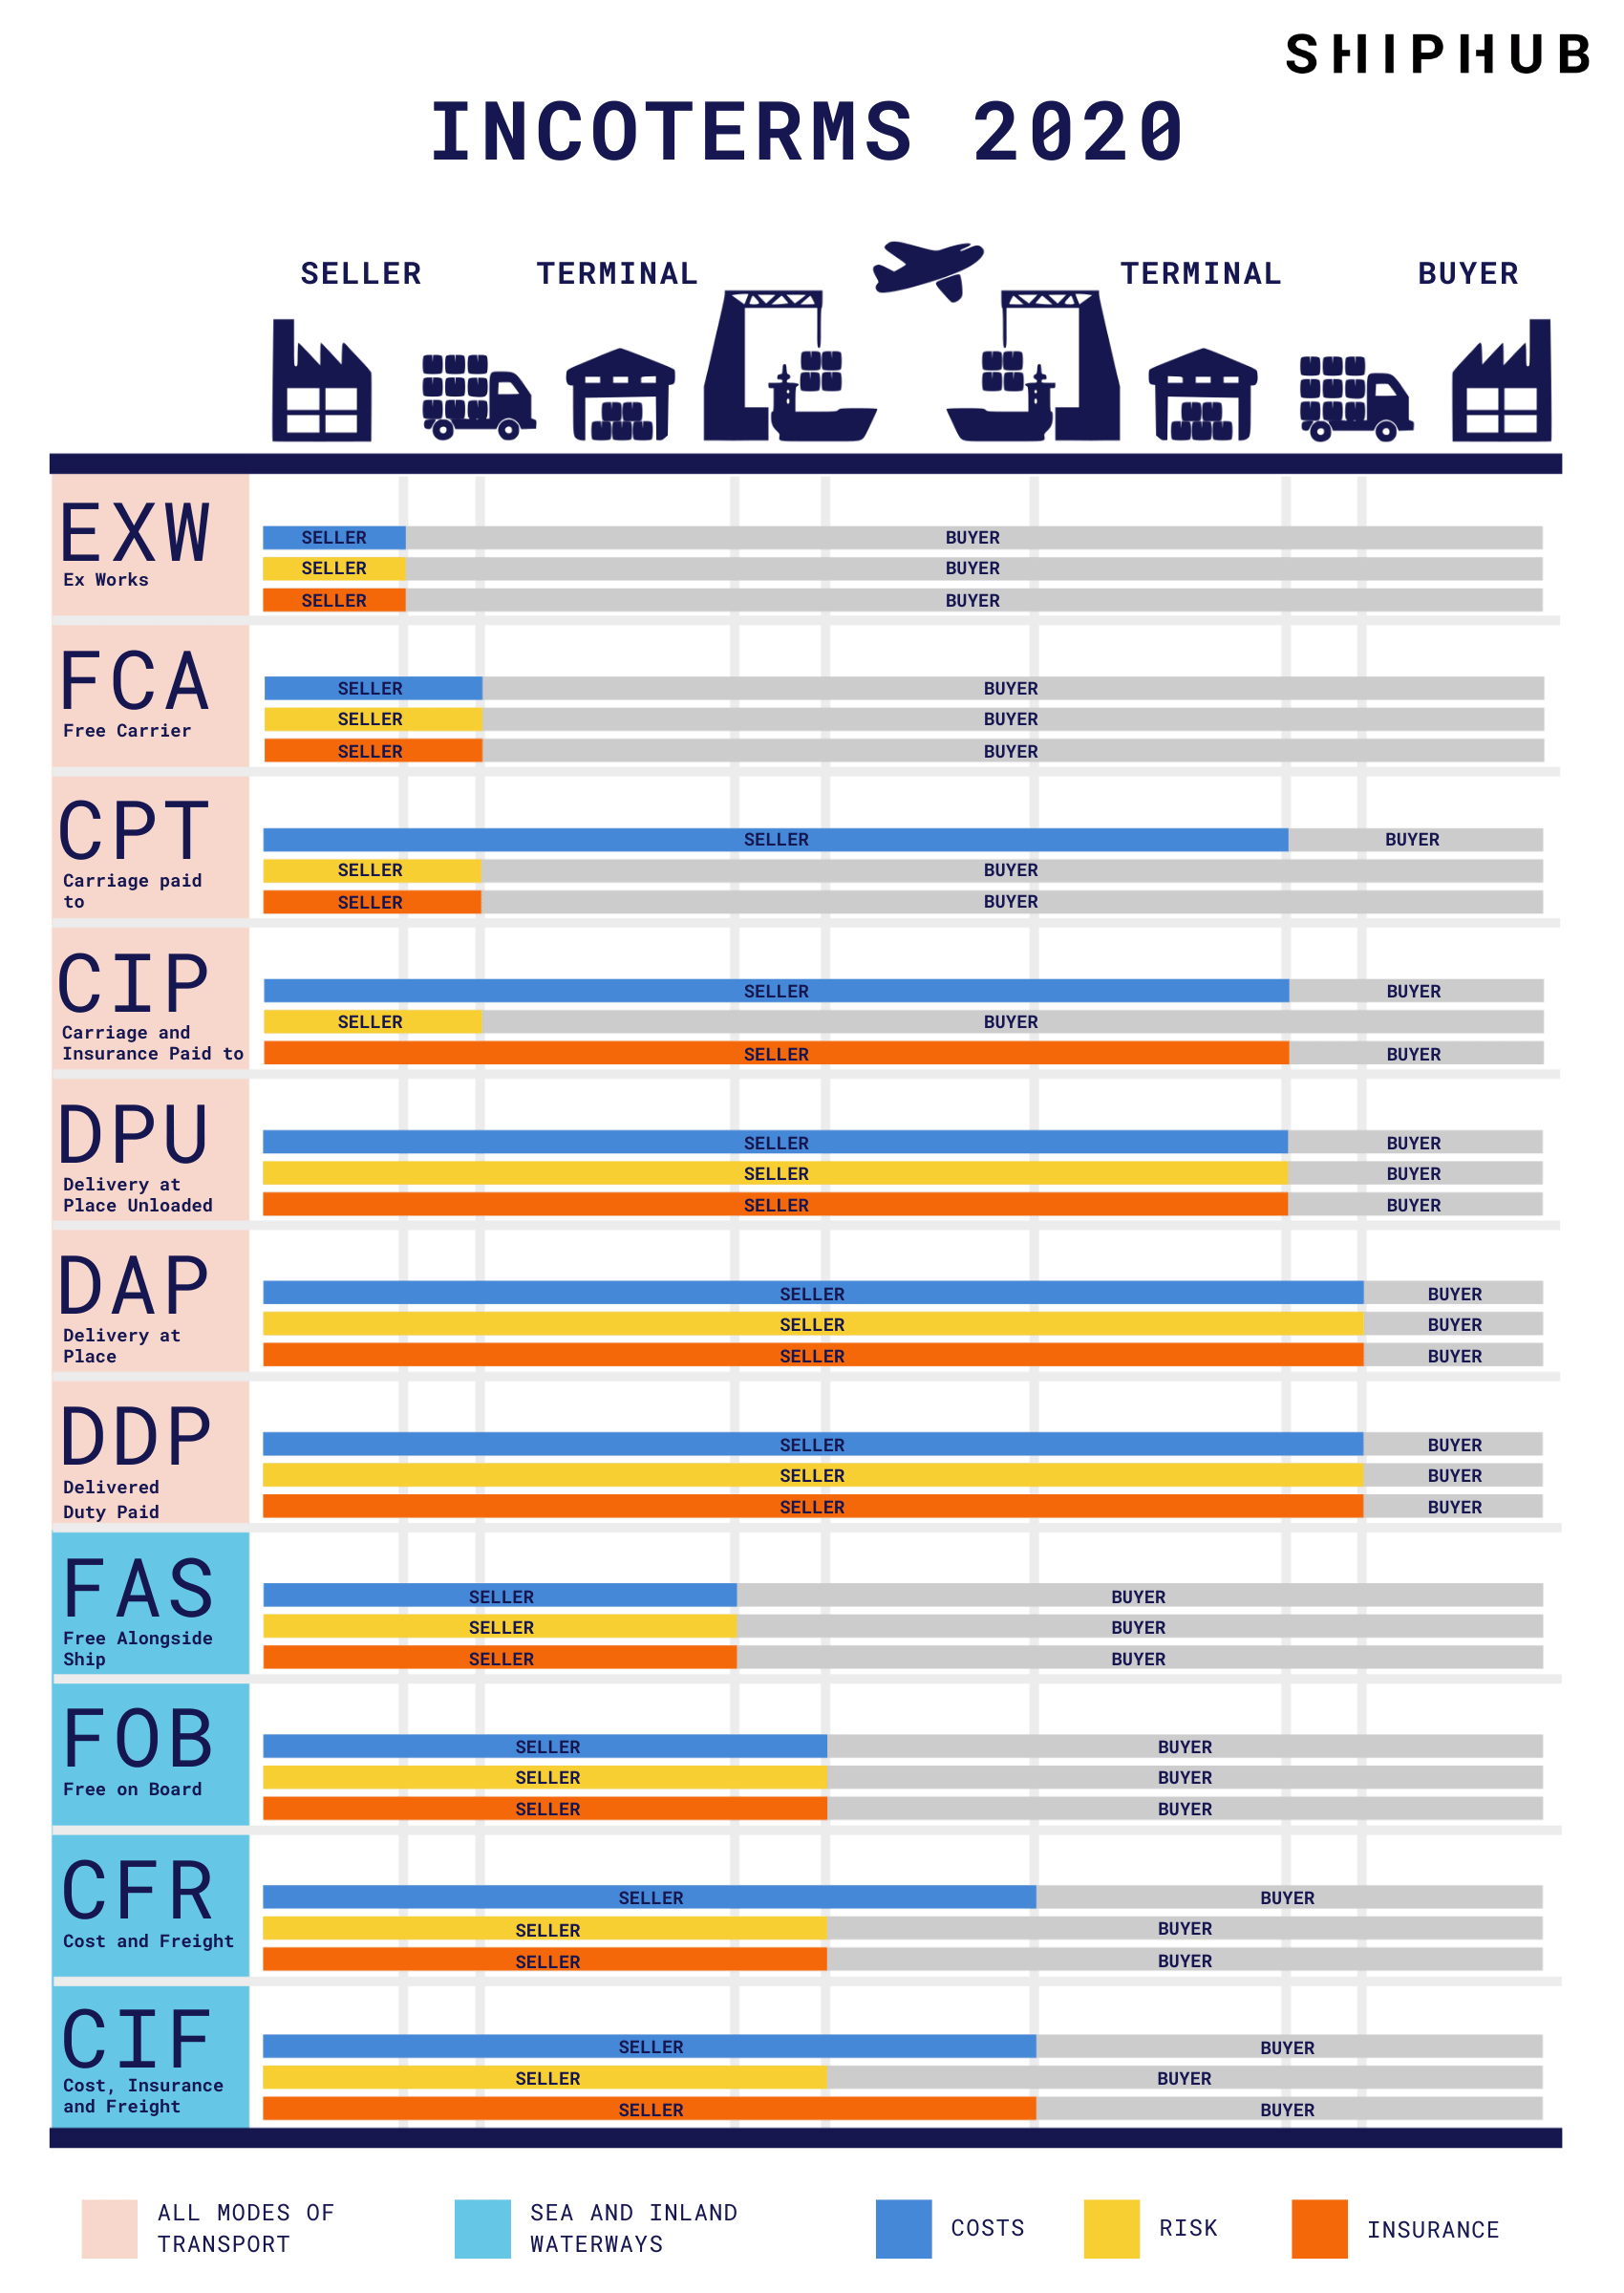
Cargo Insurance – Brief Overview
Why should a Freight Forwarder propose Cargo Insurance?
Protecting the Cargo Owner - Covers loss/damage of the Cargo
Opportunity to Add-Value
Risk Management Tool – made easy by WAVE
Peace of mind to your client
Keep your client’s sticky by solving a large portion of their logistics problem
Add to your revenue stream
Contractual requirement
i.e., to comply to Inco-terms
Lastly – Our Claim Ethos
Make you look good
Keep your client happy

Slide 9
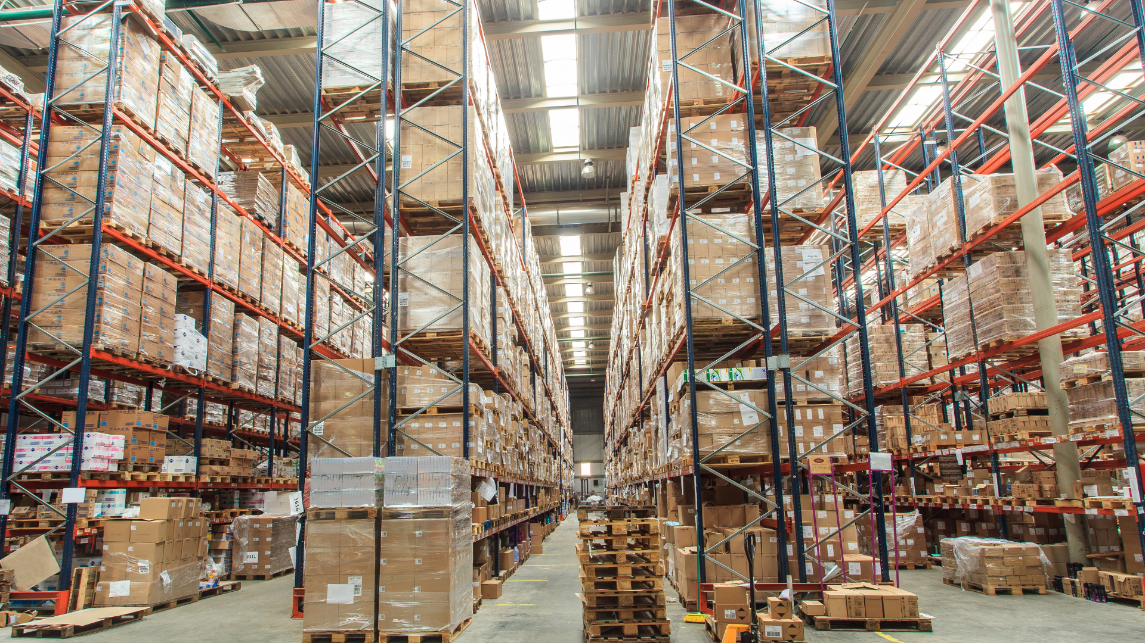
Forwarder Protect Program
Errors & Omissions
Failure of your staff to follow instructions
Mistakes in preparation of documents
Improper release of cargo
Fines and penalties by customs
Accidental delivery to wrong destination
Incorrect import product classification
Delay due to your negligence
Cargo Liability
Cargo damage and loss in transit
Costs arising from abandoned cargo
Forwarding costs
Loss or damage to cargo in store
Liability in respect to General Average
Consequential loss
Damage to 3rd party equipment and containers
Delay
Defence
Defence of all claims made against assured
All defense costs on account of insurers, including claims falling below deductible
Claims occurrence policy
In-house bill of lading terms and conditions
In-house claims support and advice

Slide 10
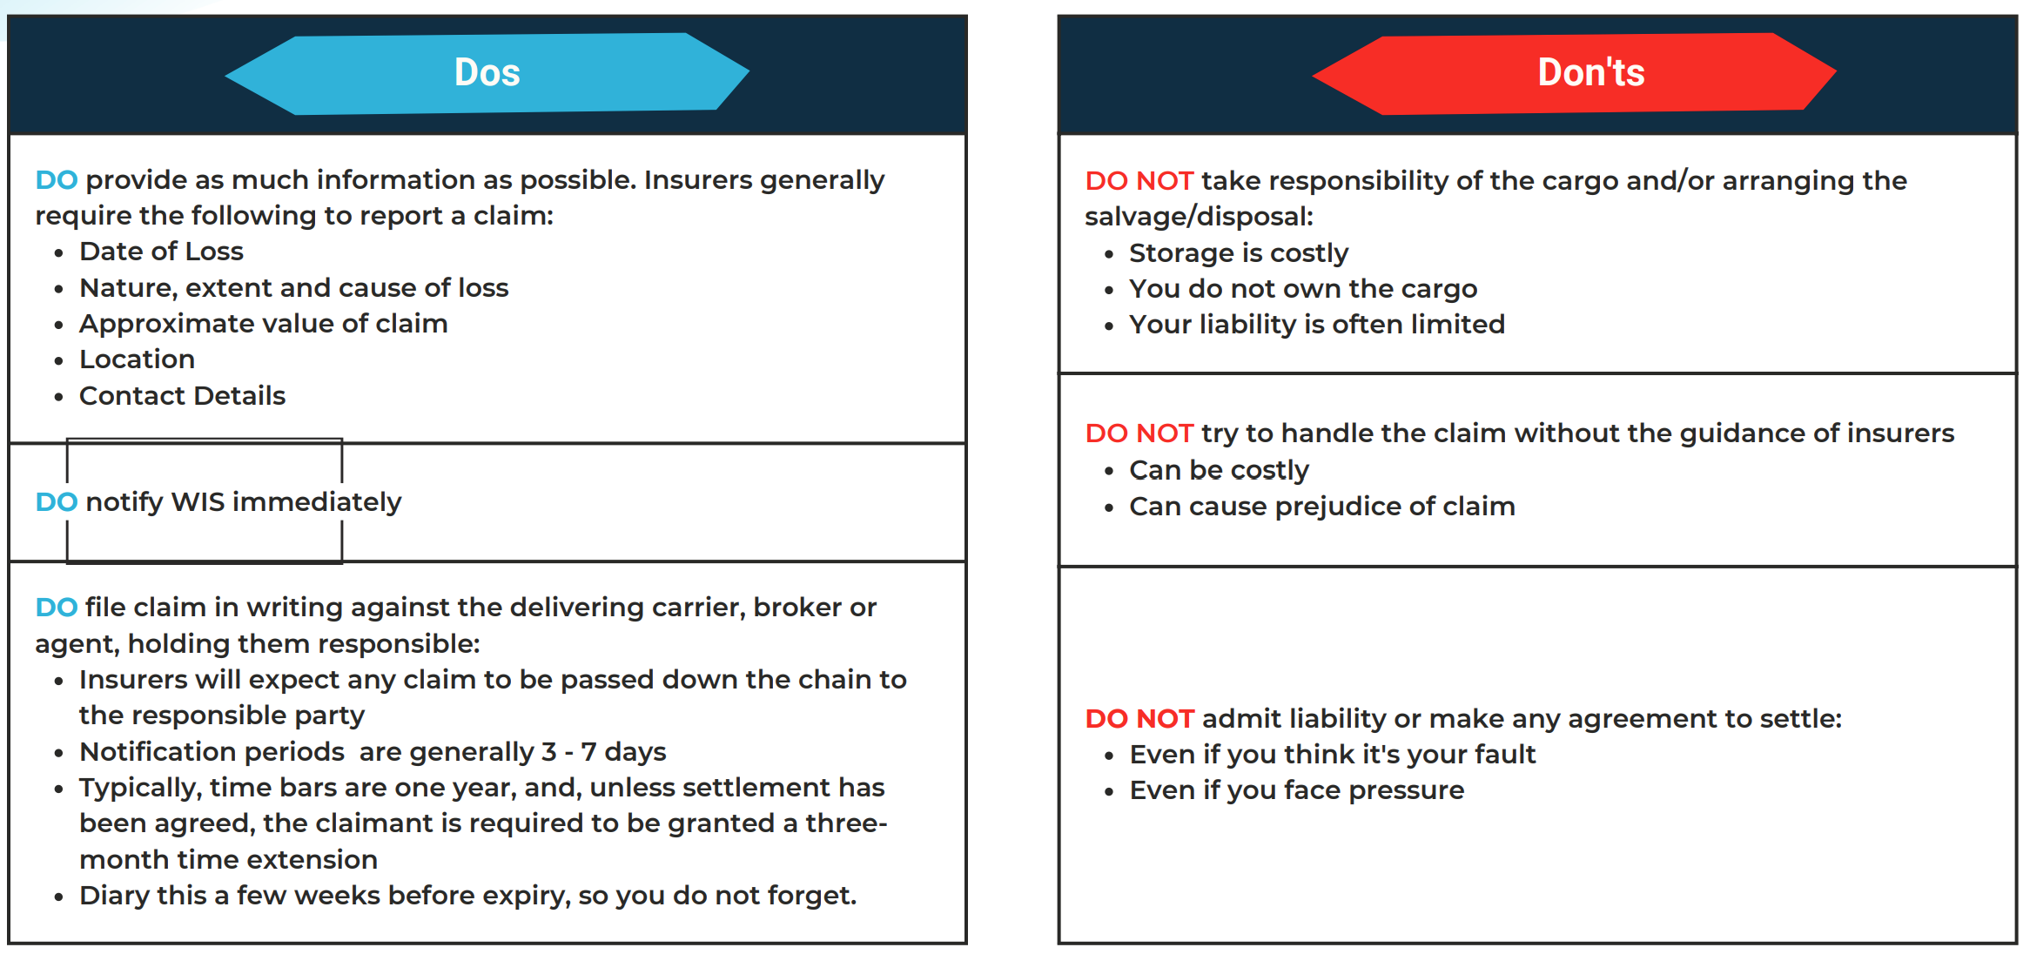
Do’s & Don’ts When Submitting a Claim
DO’s
DON’Ts

Slide 11
Why Do You Need Freight Liability Insurance?
Provides assurance goods will be handled with care and any damage/loss will be properly addressed
Provides protection against financial losses for any potential claims or lawsuits that may arise from loss, damage, or delay of cargo
Compliance with contractual requirements
Enhanced credibility and trust
Coverage for legal defence costs in the event of a claim or lawsuit
Peace of mind for customers knowing if something goes wrong during the transportation of their goods, they have a recourse for compensation
Protection against unforeseen events by providing financial protection for both the freight forwarder and their customers
Note: Liability insurance requirements and coverage may vary. Consult with your insurance professional to determine the specific needs and best options for your business.

Slide 12
Risk Managed

Slide 13
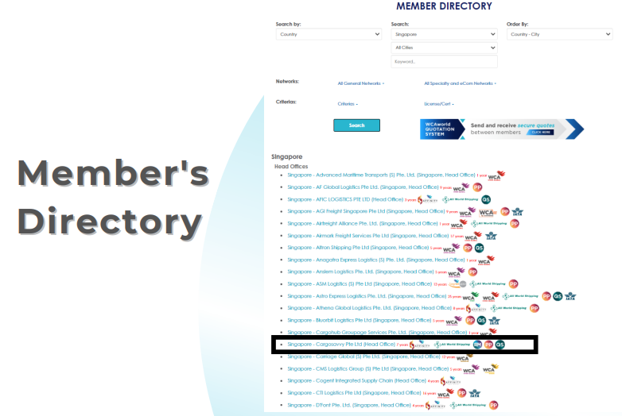
Risk Managed

Slide 14
Cargo Insurance V. Freight Forwarders Liability
 | Cargo Insurance | Freight Forwarders Liability
Who it Protects | Cargo Owner (shipper/consignee). Note, subrogation waiver will prevent subrogation actions against the Freight Forwarder. | Freight Forwarder.
Basis | Indemnity for cargo damage or loss. Narrow – although “All Risk” with ICC (A) - Cargo loss/damaged - General Average Claims | Liability and defence-based cover. Key Pillar - E&O (negligence) - Cargo Liability - Defence - Ground up defence and advisory, even before the deductible is reached
Coverage for Delay and Storage Costs | No. | Yes, but only to the extent you are liable for it.
Why arrange it? | Add-Value Service. Reduces conflicts and your liability. Customer service opportunity. Keep customers happy | Protects your balance sheet by protecting and defending your company STCs, BL Terms are not guarantees, they still need to be defended and can be overruled.
What World Insurance Do? | Advocate for your customer. Happy to take over the claims process. Goal is to make you look good! | We work closely with your insurers to advocate for you.

Slide 15
FMC Bonds & Registration
19th SINO Conference, 11-14 September 2023

Slide 16
Why Consider FMC Registration?
Global Credibility
Legal Compliance
Access to U.S. Market Rates
Dispute Resolution
US Customs Filing (AMS/ISF)

Slide 17
FMC NVOCC Bonds ($150K USD)
Covered by the FMC Bond
Cargo Loss or Damage
Unpaid Freight Charges
Non-performance or Negligence
Not Covered by the FMC Bond
Commercial Disputes
Contractual Obligations
Regulatory Violations

Slide 18
FMC Registration Process

Slide 19
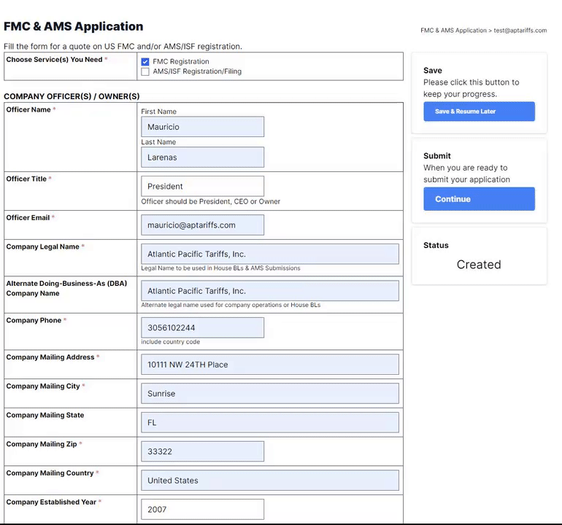
Applying for FMC Registration
Fill out FMC form with financial statements.
Check below to apply
https://tariff.aptariffs.com/registrations/new?a=wca

Slide 20
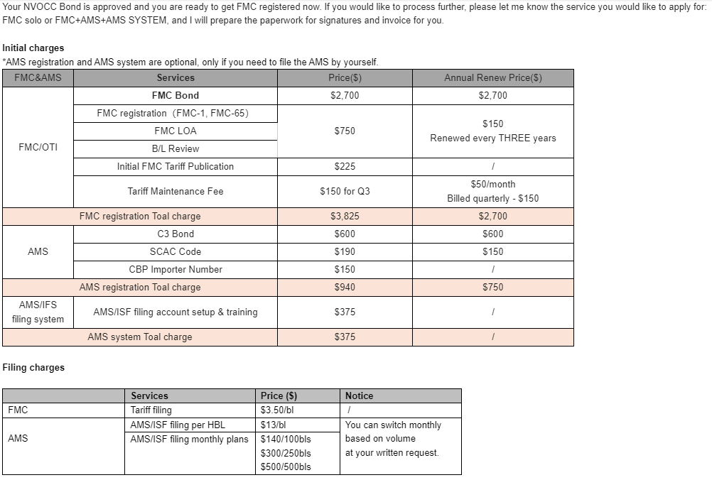
Applying for FMC Registration
Determine eligibility & get a quote (1-3 days).
Discounted bond for

Slide 21
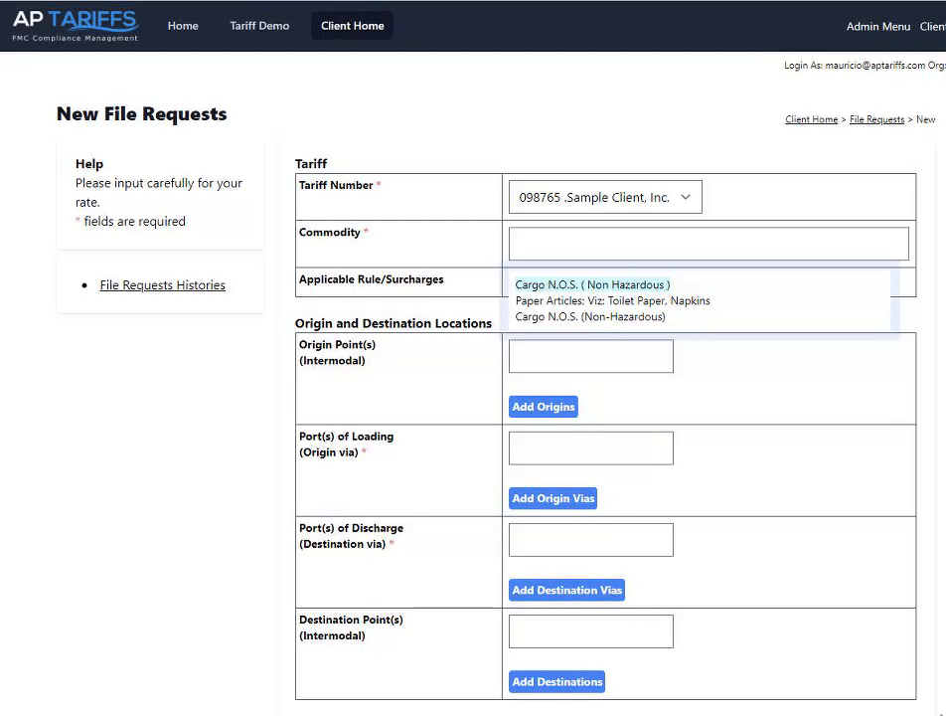
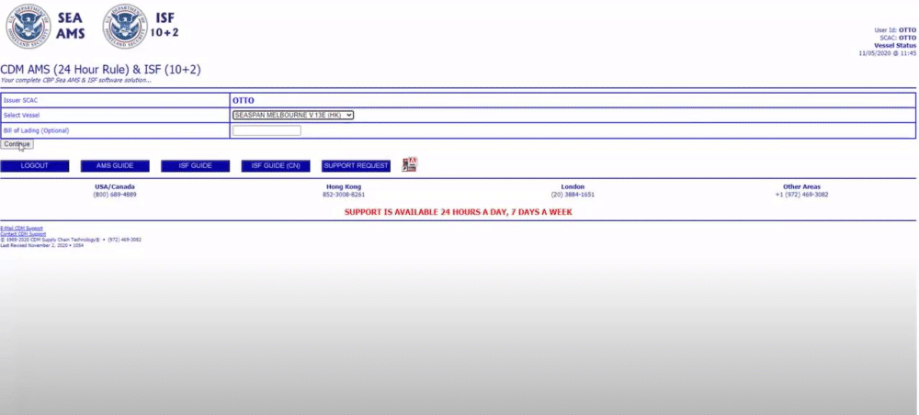
FMC/AMS Compliance Training Session

Slide 22
Contact Us
WEBSITE
www.worldinsuranceagency.com
EMAIL
customercare@worldinsuranceagency.com
anmol@worldinsuranceagency.com

